Slide 1




Types of Data Analytics
Descriptive
Predictive
Prescriptive
Aims to help uncover valuable insight from the data being analyzed
Answers the question
“What happened?”
Helps forecast behavior of people and markets
Answers the question
“What could happen?”
Suggests conclusions or actions that may be taken based on the analysis
Answers the question “What should be done?”

Slide 2


Predictive Analytics:
Business intelligence technology that produces a predictive score for each customer or prospect
34
12
34
34
34
34
34
34
12
12
12
12
12
27
79
42
59
27
27
27
79
79
42
59
Prediction Impact, Inc.

Slide 3
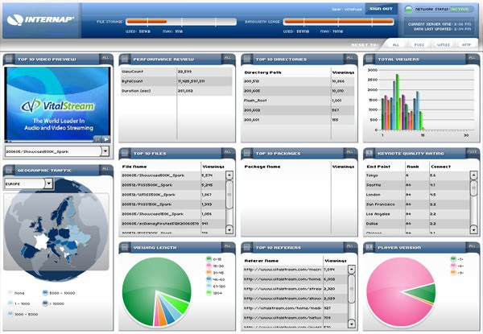

Optimizing Business Processes
“At a time when companies in many industries offer similar products and use comparable technology, high-performance business processes are among the last remaining points of differentiation.”
- Tom Davenport

Slide 4

Learn from Organizational Experience
Data is a core strategic asset –
it encodes your business’ collective experience
It is imperative to:
Learn from your data.
Learn as much as possible about your customers.
Learn how to treat each customer individually.

Slide 5

Predictive Analytics:
Your organization learns from its collective experience
Collective experience: Sales records, customer profiles, …
Learn: Discover strategic insights and business intelligence Discover something that makes business decisions
automatically Discover business rules
…and puts this knowledge to action.

Slide 6



Wisdom Gained: A Predictive Model is Built
Customer profiles
Modeling tool
Customer behavior
Predictive model
Performed by modeling software
Usually offline
Customer contact logs

Slide 7



Applying a Model to Score a Customer
Customer profile
Predictive model
Customer behavior
Predicted response
Often performed by modeling software
Possibly online

Slide 8

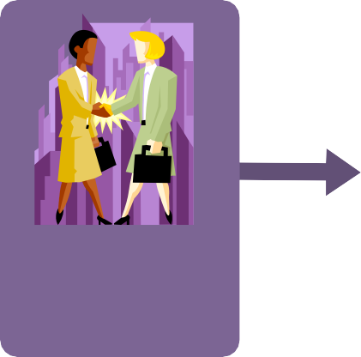

Deploy to Take Business Action
Business actions, such as:
Mail a solicitation
Suggest a
cross-sell option
Retain with a promotion
Business logic
Predicted response
Usually not performed by modeling software
Possibly online

Slide 9

Fine-Tuned Models for Your Business
Predictive models are created automatically from your data
So, they’re generated according to your:
Product
Prediction goal
Business model
Customer base
This means customer intelligence specialized for your business
Customized business rules
Unique, proprietary mailing lists
Insights only your organization could possibly gain

Slide 10


Predictors: Building Blocks for Models
recency – How recent was the last purchase?
personal income – How much to spend?
Combine predictors for better rankings:
recency + personal income 2_recency + personal income

Slide 11




Why Not Memorize The Training Examples?
To learn from history is to remember history.
So, we could just keep a lookup table and compare new cases to old ones.
Answer: There are too many possible rows of data. That is, each customer is unique!

Slide 12

Predictive Models Score Each Customer
Each customer is scored with a response probability
The customers are listed in order of prediction score
The highest-scoring customers are targeted first
ID number: | Name: | Score: | Response:
429 | E. Siegel | 35% | Yes ☺
528 | D. Leong | 31% | No ☹
256 | G. Clooney | 22% | Yes ☺
674 | T. Mitchel | 14% | No ☹

Slide 13


Campaign Profit Curve
Profit
400,000
300,000
200,000
100,000
0
-100,000
-200,000
-300,000
-400,000
-500,000
-600,000
-700,000
0%
25%
50%
75%
100%
Percent of Customers Contacted
Customers ranked with predictive analytics Customers not ranked
© Copyright 2008. All Rights Reserved. _{Prediction Impact, Inc.}
18

Slide 14

Predictive Analytics Initiatives
Per-customer predictions: Unlimited range of business objectives
Management: An organizational process ensures predictions are actionable, driven by business needs; multiple roles and skills
Deployment: Mitigate risk and track performance

Slide 15

Predictive Analytics Technology
Data preparation: An intensive bottleneck, critical to success
Modeling methods and tools: No one method that is always best; compare multiple methods

